Slide 1
Project Objective
Objective
The objective of this project is to analyze supermarket sales data and extract meaningful insights that support business decision-making.
Key goals:
Understand sales trends
Identify customer behavior
Visualize important business metrics
Apply statistical analysis

Slide 2
Task 1: Data Immersion & Wrangling
Data Preparation
Steps performed:
Uploaded the supermarket sales dataset
Explored dataset structure
Checked missing values
Removed duplicates
Standardized column names
Created a cleaned dataset ready for analysis
This step ensured the dataset was accurate and reliable.

Slide 3
Task 2: Exploratory Data Analysis
EDA Insights
Performed descriptive analysis and visualizations:
Sales distribution using histograms
Product line sales comparison using bar charts
Payment method usage analysis
These visualizations helped identify patterns and trends in the data.

Slide 4
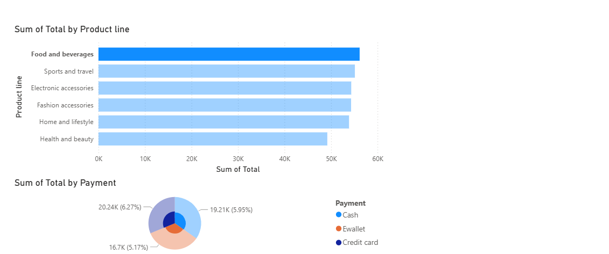
Task 3: Interactive Dashboard
Power BI Dashboard
An interactive dashboard was created using Power BI to visualize key metrics.
Dashboard include:
Total sales overview
Sales by product line
Sales by city
Payment method distribution
Customer rating analysis
This dashboard helps businesses monitor performance

Slide 5
Task 4: Hypothesis Testing
Statistical Validation
Hypothesis:
Customers using E-wallet spend more than customers using Cash
T-test results:
T-statistic: 0.4009
P-value: 0.6886
Conclusion:
Since the p-value is greater than 0.05, there is no statistically significant difference between the spending of E-wallet and Cash users.

Slide 6
Key Insights
Important findings from the analysis:
Sales vary across different product lines
Customers use multiple payment methods
Customer ratings are generally positive
Sales distribution is relatively balanced
These insights can help businesses improve decision-making.

Slide 7
Skills Developed
During this internship, I developed skills in:
Data Cleaning
Data Visualization
SQL Querying
Dashboard Development
Hypothesis Testing
Data Storytelling

Slide 8
Conclusion
This internship provided practical experience in data analysis and business intelligence.
Key outcomes:
Learned how to transform raw data into insights
Built interactive dashboards
Applied statistical methods to validate findings
This project demonstrates a complete end-to-end data analysis workflow.

